Slide 1
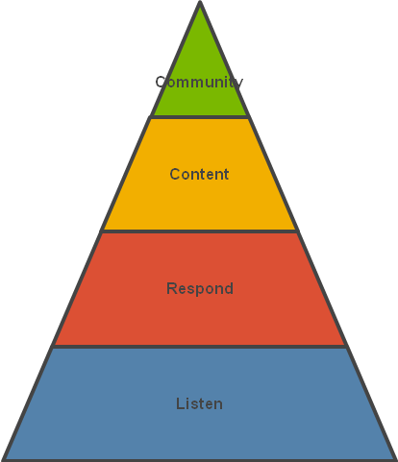
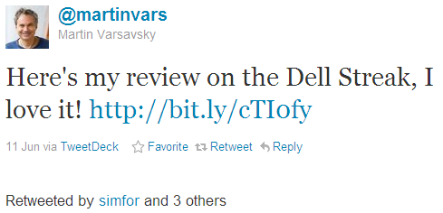
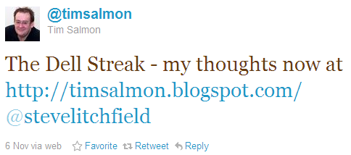
Mu Sigma developed a framework to identify influencers to create positive buzz before a product launch
Influencer Identification
Background
Insights/Recommendations
The client is a Fortune 500 manufacturer and retailer of technology products
The client wants to identify key influencers who can become brand advocates for a new product to be launched. These influencers will be given a demo product for review and buzz creation
Currently there is no framework in place to identify these influencers
A list of influencers using the framework was generated. Examples:
Klout score: 73
Followers: 18,880
Tech entrepreneur and investor,
Klout score: 51
Followers: 791
Co-host of Phones Show Chat
Analytical Approach
Business Impact
The tweets were filtered for particular keywords that signify a non-professional touch to the post. E.g.: “my review”, “my thoughts”, “my experience”, “my blog”, etc.
Then these tweets were checked for the Klout score of the author, the number of followers he has and his profession
The influencers that were selected generated significant buzz about the product which resulted in an increase in website traffic to the official product page
The reviews written by the influencers maintained a high positive sentiment for the product
There was an 13% increase in sales than expected values which can be attributed to the high positive sentiment
The impact created by these influencers led to a better Net Promoter Score (NPS) for the client
Tweet
Cloud
Keyword
funnel
Checks –
Klout score
Followers
Profession
Influencer

